Slide 1
CIS 490H/590J Edge Computing
Network Basics
Winter 2023
Prof. Zheng Song
zhesong@umich.edu

Slide 2

Outline
Network Edge and Core
Network Performance measurement
Network Application Architecture: C/S vs. P2P
TCP/UDP & Socket
Content Distribution Network (CDN)
Mobile and wireless network
SDN and NFV
Slides adopted from Computer Networking: A Top Down Approach

Slide 3
















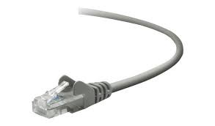
The Internet: a “nuts and bolts” view
Billions of connected computing devices:
hosts = end systems
running network apps at Internet’s “edge”
mobile network
national or global ISP
Packet switches: forward packets (chunks of data)
routers, switches
local or regional ISP
Internet
Communication links
fiber, copper, radio, satellite
transmission rate: bandwidth
home network
content
provider
network
datacenter
network
Networks
collection of devices, routers, links: managed by an organization
enterprise
network

Slide 4
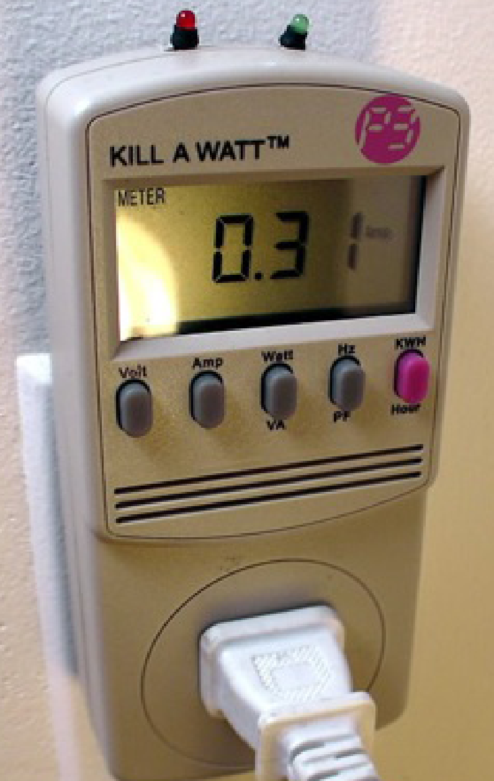


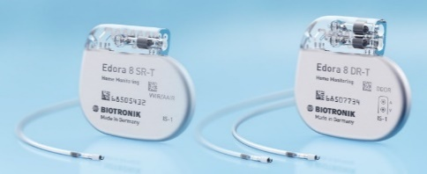
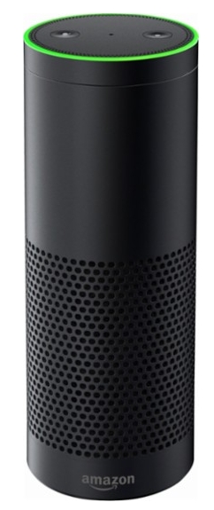


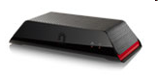
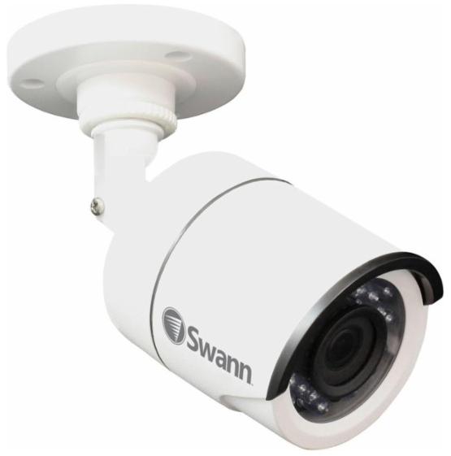



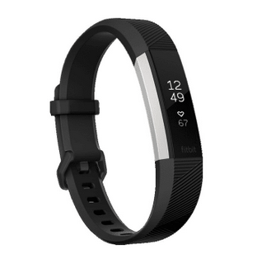
“Fun” Internet-connected devices
Pacemaker & Monitor
Tweet-a-watt:
monitor energy use
Amazon Echo
IP picture frame
Web-enabled toaster +
weather forecaster
Internet
refrigerator
Slingbox: remote
control cable TV
Security Camera
AR devices
sensorized,
bed
mattress
Others?
Internet phones
Fitbit

Slide 5
A closer look at Internet structure
mobile network
Network edge:
hosts: clients and servers
servers often in data centers
national or global ISP
local or regional ISP
home network
content
provider
network
datacenter
network
enterprise
network

Slide 6
A closer look at Internet structure
mobile network
Network edge:
hosts: clients and servers
servers often in data centers
Access networks, physical media:
wired, wireless communication links
national or global ISP
local or regional ISP
home network
content
provider
network
datacenter
network
enterprise
network

Slide 7
A closer look at Internet structure
mobile network
Network edge:
hosts: clients and servers
servers often in data centers
Access networks, physical media:
wired, wireless communication links
Network core:
interconnected routers
network of networks
national or global ISP
local or regional ISP
home network
content
provider
network
datacenter
network
enterprise
network

Slide 8
The network core
mesh of interconnected routers
packet-switching: hosts break application-layer messages into packets
forward packets from one router to the next, across links on path from source to destination
each packet transmitted at full link capacity
mobile network
national or global ISP
local or regional ISP
home network
content
provider
network
datacenter
network
enterprise
network

Slide 9
Two key network-core functions
routing algorithm
Routing:
global action: determine source-destination paths taken by packets
routing algorithms
routing algorit
Forwarding:
local action: move arriving packets from router’s input link to appropriate router output link
local forwarding table
local forwarding table
header value
output link
0100
0101
0111
1001
3
2
2
1
1
3
2
0111
destination address in arriving
packet’s header

Slide 10
Internet structure: a “network of networks”
Tier 1 ISP
Tier 1 ISP
Google
IXP
IXP
IXP
Regional ISP
Regional ISP
access
ISP
access
ISP
access
ISP
access
ISP
access
ISP
access
ISP
access
ISP
access
ISP
At “center”: small # of well-connected large networks
“tier-1” commercial ISPs (e.g., Level 3, Sprint, AT&T, NTT), national & international coverage
content provider networks (e.g., Google, Facebook): private network that connects its data centers to Internet, often bypassing tier-1, regional ISPs

Slide 11
Outline
Network Edge and Core
Network Performance measurement
Network Application Architecture: C/S vs. P2P
TCP/UDP & Socket Programming
Content Distribution Network (CDN)
Mobile and wireless network
SDN

Slide 12

How do packet loss and delay occur?
packets queue in router buffers
packets queue, wait for turn
arrival rate to link (temporarily) exceeds output link capacity: packet loss
packet being transmitted (transmission delay)
A
B
packets in buffers (queueing delay)
free (available) buffers: arriving packets
dropped (loss) if no free buffers

Slide 13
Packet delay: four sources
transmission
A
propagation
B
processing
queueing
Delay = d_{proc} + d_{queue} + d_{trans} + d_{prop}
d_{proc}: processing
check bit errors
determine output link
typically < msec
d_{queue}: queueing delay
time waiting at output link for transmission
depends on congestion level of router

Slide 14
Packet delay: four sources
transmission
A
propagation
B
processing
queueing
d = d_{proc} + d_{queue} + d_{trans} + d_{prop}
d_{trans}: transmission delay:
L: packet length (bits)
R: link transmission rate (bps)
d_{trans} = L/R
d_{prop}: propagation delay:
d: length of physical link
s: propagation speed (~2x10⁸ m/sec)
d_{prop} = d/s
d_{trans} and d_{prop}
very different

Slide 15
How to reduce Latency?
Reduce the number of hops (processing delay)
Reduce the distance from sender to receiver (propagation delay)
Better network interfaces (reduce transmission delay)
No congestion (queue delay)

Slide 16
Real Internet delays and routes
traceroute: gaia.cs.umass.edu to www.eurecom.fr
3 delay measurements from
gaia.cs.umass.edu to cs-gw.cs.umass.edu
1 cs-gw (128.119.240.254) 1 ms 1 ms 2 ms
2 border1-rt-fa5-1-0.gw.umass.edu (128.119.3.145) 1 ms 1 ms 2 ms
3 cht-vbns.gw.umass.edu (128.119.3.130) 6 ms 5 ms 5 ms
4 jn1-at1-0-0-19.wor.vbns.net (204.147.132.129) 16 ms 11 ms 13 ms
5 jn1-so7-0-0-0.wae.vbns.net (204.147.136.136) 21 ms 18 ms 18 ms
6 abilene-vbns.abilene.ucaid.edu (198.32.11.9) 22 ms 18 ms 22 ms
7 nycm-wash.abilene.ucaid.edu (198.32.8.46) 22 ms 22 ms 22 ms
8 62.40.103.253 (62.40.103.253) 104 ms 109 ms 106 ms
9 de2-1.de1.de.geant.net (62.40.96.129) 109 ms 102 ms 104 ms
10 de.fr1.fr.geant.net (62.40.96.50) 113 ms 121 ms 114 ms
11 renater-gw.fr1.fr.geant.net (62.40.103.54) 112 ms 114 ms 112 ms
12 nio-n2.cssi.renater.fr (193.51.206.13) 111 ms 114 ms 116 ms
13 nice.cssi.renater.fr (195.220.98.102) 123 ms 125 ms 124 ms
14 r3t2-nice.cssi.renater.fr (195.220.98.110) 126 ms 126 ms 124 ms
15 eurecom-valbonne.r3t2.ft.net (193.48.50.54) 135 ms 128 ms 133 ms
16 194.214.211.25 (194.214.211.25) 126 ms 128 ms 126 ms
17 * * *
18 * * *
19 fantasia.eurecom.fr (193.55.113.142) 132 ms 128 ms 136 ms
3 delay measurements
to border1-rt-fa5-1-0.gw.umass.edu
trans-oceanic link
looks like delays decrease! Why?
* means no response (probe lost, router not replying)
* Do some traceroutes from exotic countries at www.traceroute.org

Slide 17
Throughput
throughput: rate (bits/time unit) at which bits are being sent from sender to receiver
instantaneous: rate at given point in time
average: rate over longer period of time
link capacity
R_{s} bits/sec
link capacity
R_{c} bits/sec
pipe that can carry
fluid at rate
(R_{s} bits/sec)
pipe that can carry
fluid at rate
(R_{c} bits/sec)
server sends bits
(fluid) into pipe
server, with
file of F bits
to send to client

Slide 18
Throughput
R_{s} < R_{c} What is average end-end throughput?
R_{s} bits/sec
R_{c} bits/sec
R_{s} > R_{c} What is average end-end throughput?
R_{s} bits/sec
R_{c} bits/sec
bottleneck link
link on end-end path that constrains end-end throughput

Slide 19
Where is the bottleneck link?
The link to Data centers?
The link of our access network?
It really depends on how many users are using the same link.
10 users sharing 1Gbps (access network)
10K users sharing 1000Gbps (data center network)
Which is more likely to suffer from congestion?

Slide 20
Outline
Network Edge and Core
Network Performance measurement
Network Application Architecture: C/S vs. P2P
TCP/UDP & Socket Programming
Content Distribution Network (CDN)
Mobile and wireless network
SDN

Slide 21
Some network apps
social networking
Web
text messaging
e-mail
multi-user network games
streaming stored video (YouTube, Hulu, Netflix)
P2P file sharing
voice over IP (e.g., Skype)
real-time video conferencing
Internet search
remote login
…

Slide 22
Client-server paradigm
server:
always-on host
permanent IP address
often in data centers, for scaling
clients:
contact, communicate with server
may be intermittently connected
may have dynamic IP addresses
do not communicate directly with each other
examples: HTTP, IMAP, FTP
mobile network
national or global ISP
local or regional ISP
home network
content
provider
network
datacenter
network
enterprise
network

Slide 23
Peer-peer architecture
no always-on server
arbitrary end systems directly communicate
peers request service from other peers, provide service in return to other peers
self scalability – new peers bring new service capacity, as well as new service demands
peers are intermittently connected and change IP addresses
complex management
example: P2P file sharing
mobile network
national or global ISP
local or regional ISP
home network
content
provider
network
datacenter
network
enterprise
network

Slide 24
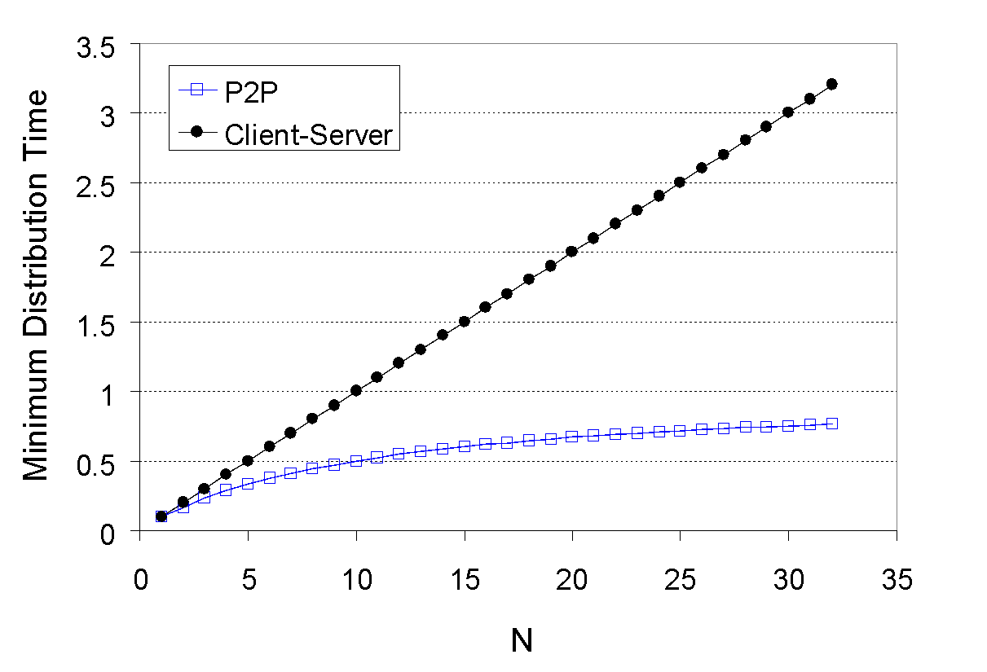
Client-server vs. P2P: example
client upload rate = u, F/u = 1 hour, u_{s} = 10u, d_{min} ≥ u_{s}

Slide 25
Outline
Network Edge and Core
Network Performance measurement
Network Application Architecture: C/S vs. P2P
TCP/UDP & Socket Programming
Content Distribution Network (CDN)
Mobile and wireless network
SDN

Slide 26
Processes communicating
process: program running within a host
within same host, two processes communicate using inter-process communication (defined by OS)
processes in different hosts communicate by exchanging messages
clients, servers
client process: process that initiates communication
server process: process that waits to be contacted
note: applications with P2P architectures have client processes & server processes

Slide 27
Sockets
process sends/receives messages to/from its socket
socket analogous to door
sending process shoves message out door
sending process relies on transport infrastructure on other side of door to deliver message to socket at receiving process
two sockets involved: one on each side
application
socket
application
controlled by
app developer
process
process
transport
transport
network
network
controlled
by OS
link
Internet
link
physical
physical

Slide 28
Addressing processes
to receive messages, process must have identifier
host device has unique 32-bit IP address
Q: does IP address of host on which process runs suffice for identifying the process?
identifier includes both IP address and port numbers associated with process on host.
example port numbers:
HTTP server: 80
mail server: 25
to send HTTP message to gaia.cs.umass.edu web server:
IP address: 128.119.245.12
port number: 80
more shortly…
A: no, many processes can be running on same host

Slide 29
Internet transport protocols services
TCP service:
reliable transport between sending and receiving process
flow control: sender won’t overwhelm receiver
congestion control: throttle sender when network overloaded
does not provide: timing, minimum throughput guarantee, security
connection-oriented: setup required between client and server processes
UDP service:
unreliable data transfer between sending and receiving process
does not provide: reliability, flow control, congestion control, timing, throughput guarantee, security, or connection setup.
Q: why bother? Why is there a UDP?

Slide 30
Outline
Network Edge and Core
Network Performance measurement
Network Application Architecture: C/S vs. P2P
TCP/UDP & Socket Programming
Content Distribution Network (CDN)
Mobile and wireless network
SDN

Slide 31





Video Streaming and CDNs: context
stream video traffic: major consumer of Internet bandwidth
Netflix, YouTube, Amazon Prime: 80% of residential ISP traffic (2020)
challenge:
scale - how to reach ~1B users?
Latency - how to avoid lagging

Slide 32


Content distribution networks (CDNs)
challenge: how to stream content (selected from millions of videos) to hundreds of thousands of simultaneous users?
store/serve multiple copies of videos at multiple geographically distributed sites (CDN)
enter deep: push CDN servers deep into many access networks
close to users
Akamai: 240,000 servers deployed in more than 120 countries (2015)
bring home: smaller number (10’s) of larger clusters in POPs near (but not within) access networks
used by Limelight

Slide 33
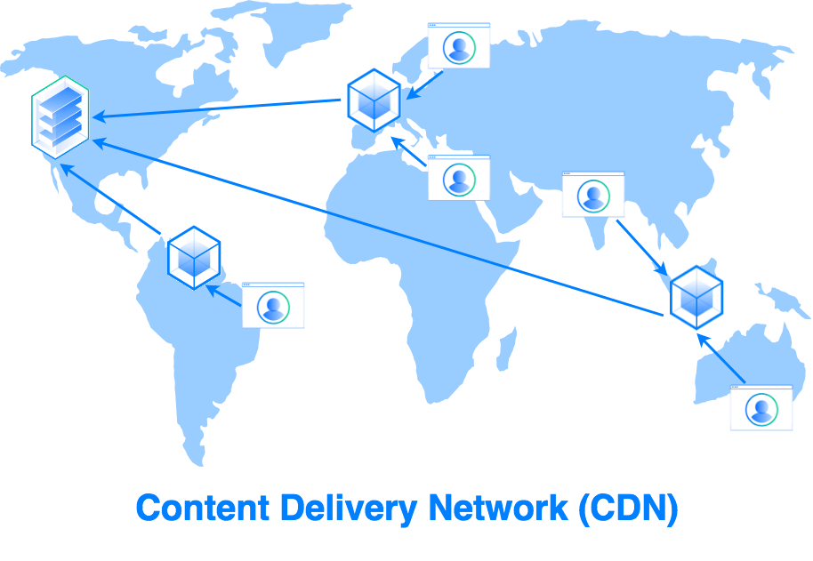
Content distribution networks (CDNs)
Notes:
33
Akamai: 100,000+ servers in 1000+ clusters in 1000+ networks in 70+ countries serving trillions of requests a day.
How many people use Netflix?

Slide 34

CDN use case
Bob (client) requests video http://netcinema.com/6Y7B23V
video stored in CDN at http://KingCDN.com/NetC6y&B23V
1. Bob gets URL for video http://netcinema.com/6Y7B23V
from netcinema.com web page
2. resolve http://netcinema.com/6Y7B23V
via Bob’s local DNS
1
2
6. request video from
KINGCDN server,
streamed via HTTP
5
Bob’s
local DNS
server
netcinema.com
3. netcinema’s DNS returns CNAME for
http://KingCDN.com/NetC6y&B23V
4
3
netcinema’s
authoratative DNS
KingCDN.com
KingCDN
authoritative DNS

Slide 35
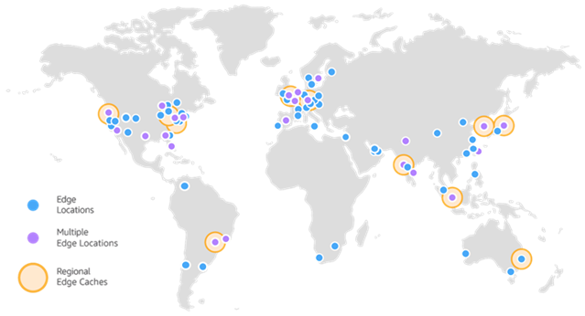
Amazon CDN: Cloudfront
100 points in 2017, 200 points in 2019.
New generation of CDN: not just storage, but also computing
https://aws.amazon.com/blogs/networking-and-content-delivery/how-to-accelerate-your-wordpress-site-with-amazon-cloudfront/
Edge locations: Washington, DC (11); Chicago, IL (19); New York, NY (10); Atlanta, GA (10); Los Angeles, CA (9); Miami, FL (11); Dallas-Fort Worth, TX (11); Houston, TX (4); San Francisco, CA (6); Boston, MA (5); Denver, CO (3); Portland, OR (2); Seattle, WA (6); Toronto, Canada (3); Minneapolis, MN (4); Phoenix, AZ (2); Querétaro, Mexico (2); Montréal, Canada (2); Philadelphia, PA (1); Salt Lake City, UT (1); Vancouver, Canada (1); Nashville, TN (2); Detroit, MI (2)

Slide 36
Outline
Network Edge and Core
Network Performance measurement
Network Application Architecture: C/S vs. P2P
TCP/UDP & Socket Programming
Content Distribution Network (CDN)
Mobile and wireless network
SDN

Slide 37
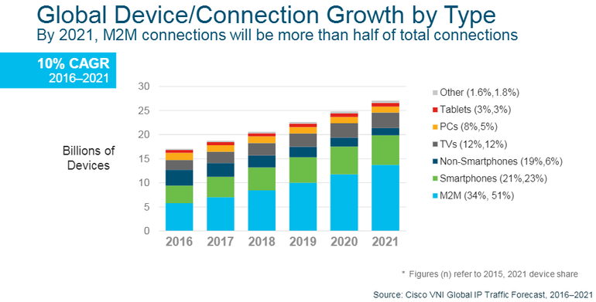
Wireless and Mobile Networks: context
M2M
Smart meters
E-readers
Medical devices
Automobiles
Office devices
Military devices…
Internet of everything (Cisco)
Smarter Planet (IBM)
Notes:
machine-to-machine (M2M) connections that support IoT applications will account for more than half of the world's 27.1 billion devices and connections.

Slide 38
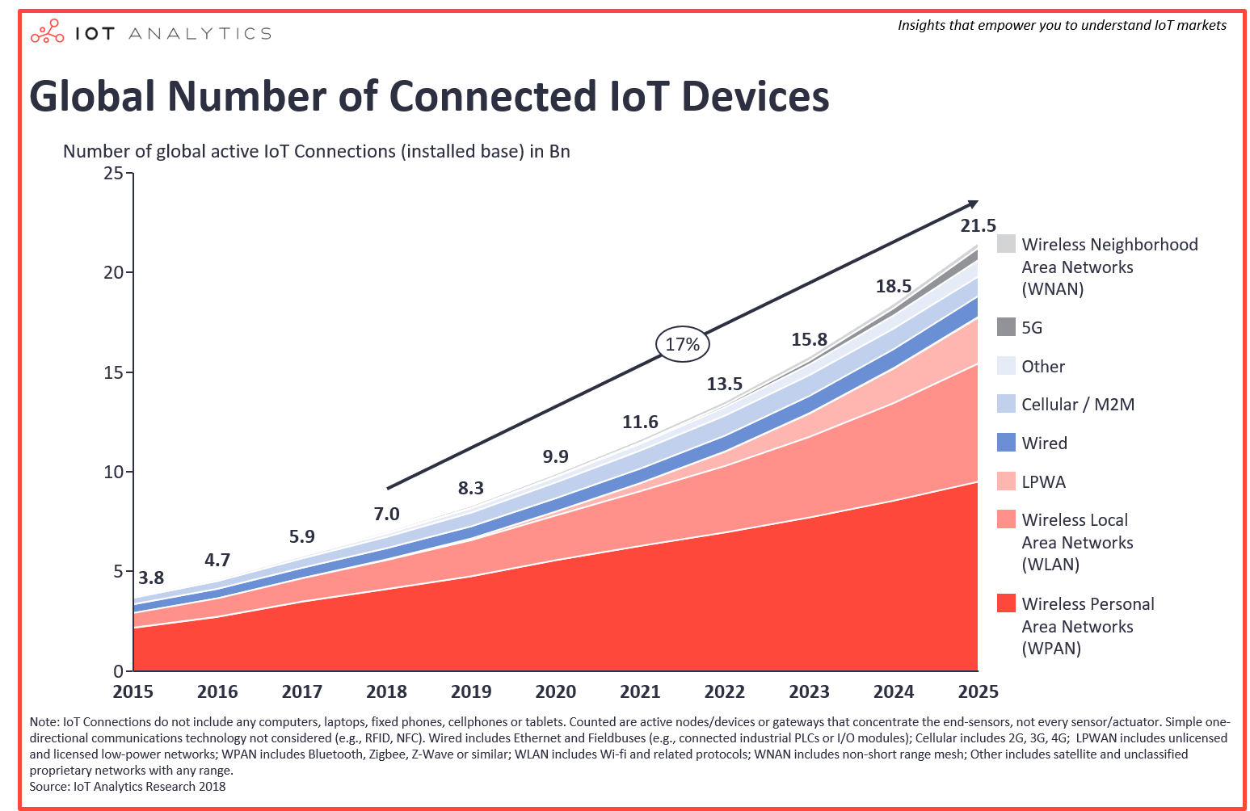
Wireless and Mobile Networks: context
Most devices/access networks go wireless!
WPAN
WLAN
LPWA (LoRa)
Cellular
5G
…
WPAN: Wireless Personal Area Network
WLAN: Wireless Local Area Network
LPWA: low power wide area network
Notes:
LPWA, low power wide area network. (Lora）

Slide 39
Outline
Wireless Communication characteristics
Different Wireless Communication technologies
WiFi: 802.11 wireless LANs
Cellular networks: 4G and 5G
Personal Area Network: BLE, Zigbee, …
LPWA: LoRa
Wireless Sensor Network
Mesh WSN
Delay Tolerant Network
VANET

Slide 40

















Elements of a wireless network
wired network
infrastructure

Slide 41



Elements of a wireless network
wireless hosts
laptop, smartphone, IoT
run applications
may be stationary (non-mobile) or mobile
wireless does not always mean mobility!
wired network
infrastructure

Slide 42

Elements of a wireless network
base station
typically connected to wired network
relay - responsible for sending packets between wired network and wireless host(s) in its “area”
e.g., cell towers, 802.11 access points
wired network
infrastructure

Slide 43
Elements of a wireless network
wireless link
typically used to connect mobile(s) to base station, also used as backbone link
multiple access protocol coordinates link access
various transmission rates and distances, frequency bands
wired network
infrastructure

Slide 44
Characteristics of selected wireless links
14 Gbps
802.11ax
10 Gbps
5G
3.5 Gbps
802.11ac
802.11 af,ah
600 Mbps
802.11n
4G LTE
54 Mbps
802.11g
11 Mbps
802.11b
2 Mbps
Bluetooth
Indoor
Outdoor
Midrange
outdoor
Long range
outdoor
10-30m
50-200m
200m-4Km
4Km-15Km
Hidden: Energy Consumption/Deployment Cost

Slide 45
Elements of a wireless network
infrastructure mode
base station connects mobiles into wired network
handoff: mobile changes base station providing connection into wired network
wired network
infrastructure

Slide 46
Elements of a wireless network
ad hoc mode
no base stations
nodes can only transmit to other nodes within link coverage
nodes organize themselves into a network: route among themselves

Slide 47
Wireless network taxonomy
single hop
multiple hops
host connects to base station (WiFi, cellular) which connects to larger Internet
host may have to relay through several wireless nodes to connect to larger
Internet: mesh net
infrastructure
(e.g., APs)
no base station, no connection to larger Internet (Bluetooth, ad hoc nets)
no base station, no connection to larger Internet. May have to relay to reach other a given wireless node MANET, VANET
no
infrastructure

Slide 48
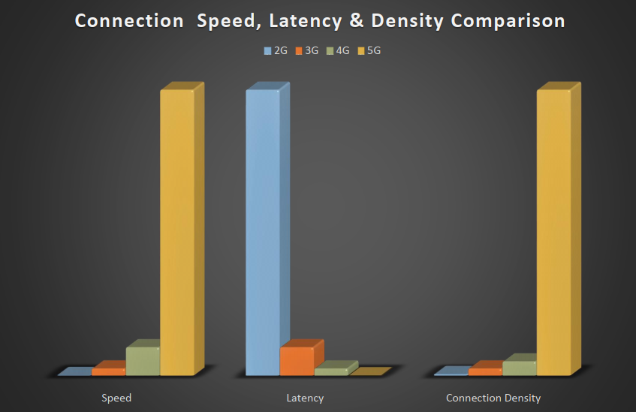
4G/5G Network
4G Focus Area
5G Focus Area
Speed/Throughput
Data
Connection Density
Latency/Delay

Slide 49
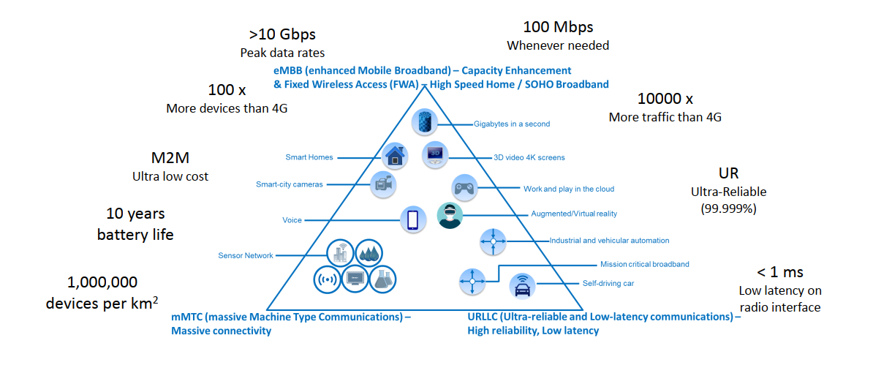
Why we need 5G?
Andrea Goldsmith, What’s Beyond 5Ghttps://www.youtube.com/watch?v=ReGofBrbuLU
https://www.youtube.com/watch?v=GEx_d0SjvS0

Slide 50
Outline
Network Edge and Core
Network Performance measurement
Network Application Architecture: C/S vs. P2P
TCP/UDP & Socket Programming
Content Distribution Network (CDN)
Mobile and wireless network
SDN/NFV

Slide 51
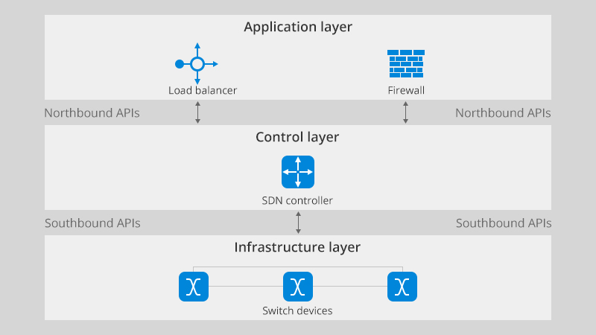
Software Defined Network
Write a program to control the network’s behavior

Slide 52

Per-router control plane
Individual routing algorithm components in each and every router interact in the control plane to computer forwarding tables
Routing
Algorithm
control
plane
data
plane
values in arriving
packet header
0111
1
3
2

Slide 53
Software defined networking (SDN)
…
3. control plane functions external to data-plane switches
4. programmable control applications
routing
access control
load
balance
Remote Controller
control
plane
data
plane
CA
2. control, data plane separation
CA
CA
CA
CA
1: generalized “flow-based” forwarding (e.g., OpenFlow)

Slide 54
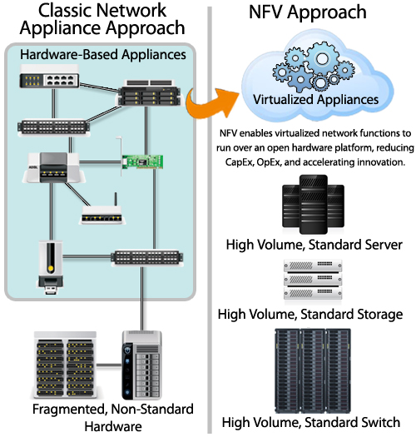
Network Function Virtualization
Network functions virtualization (NFV) is the replacement of network appliance hardware with virtual machines. The virtual machines use a hypervisor to run networking software and processes such as routing and load balancing.
While NFV separates networking services from dedicated hardware appliances, software-defined networking, or SDN, separates the network control functions such as routing,

Slide 55
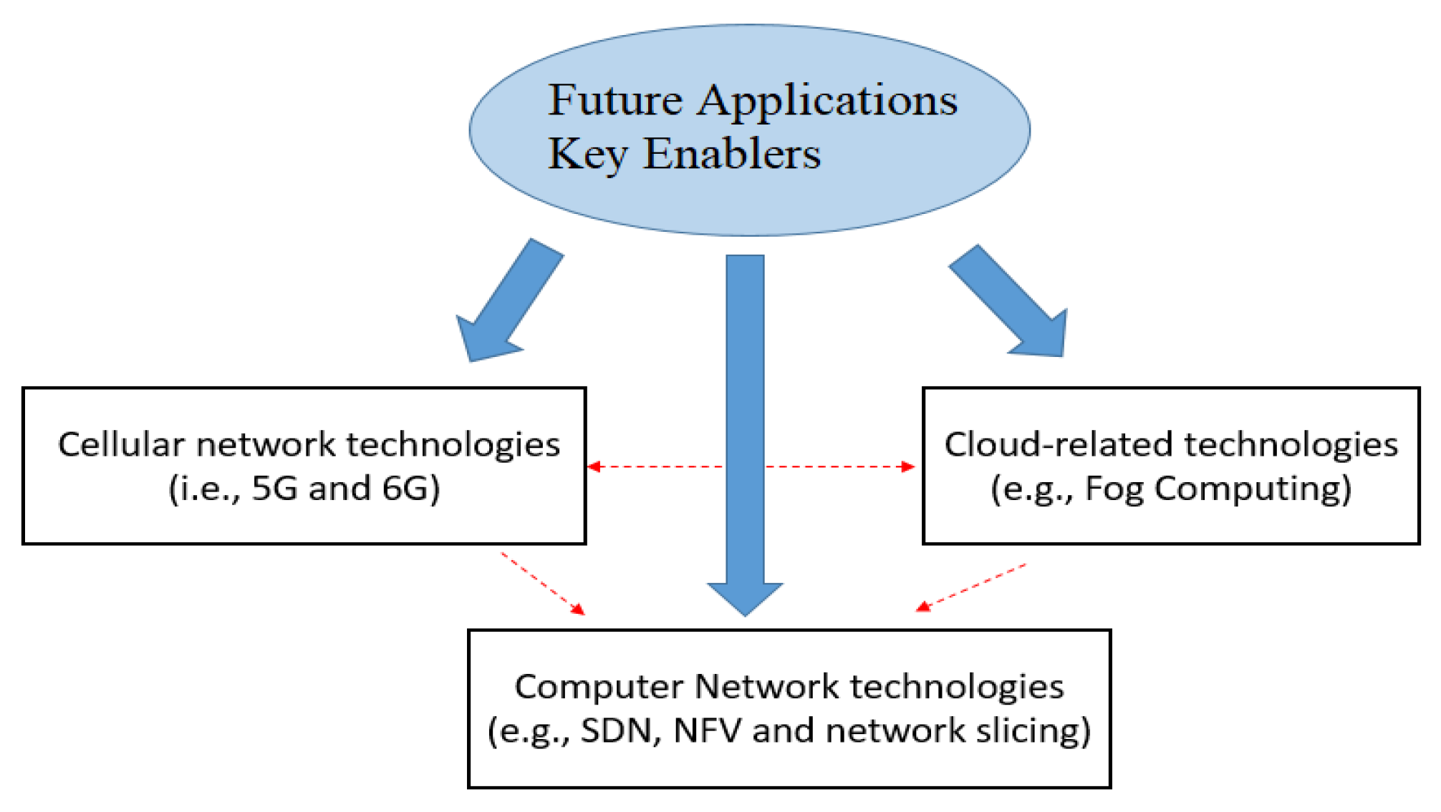
ETSI: 5G network
Key enablers:
Communication end: MIMO, Beamforming
MEC (Edge/Fog Computing)
SDN, NFV
MEC: Mobile Edge Computing provides an IT service environment and cloud-computing capabilities at the edge of the mobile network

